Slide 1
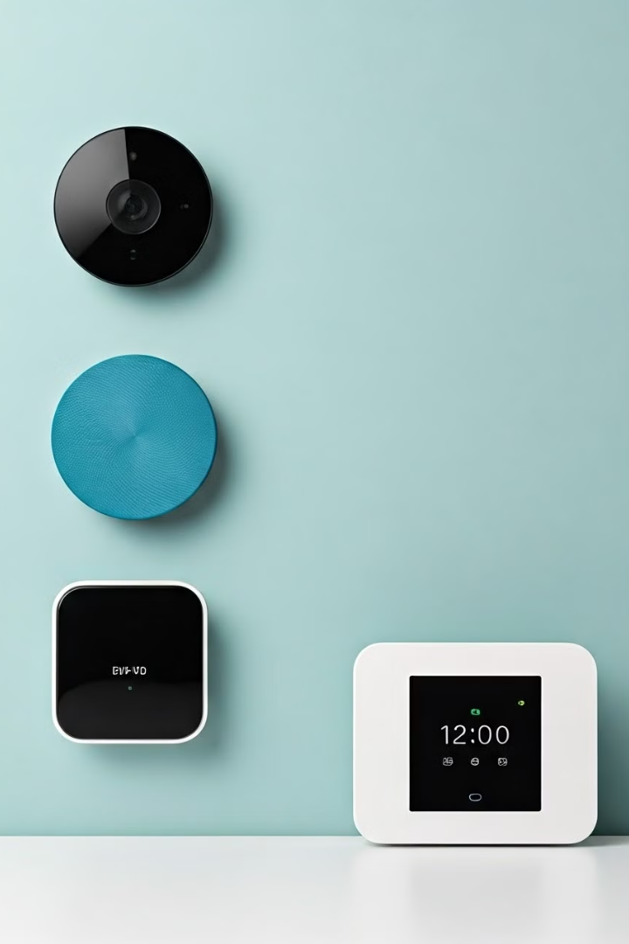

Home Automation System: A Comprehensive Project
Discover the power of a seamlessly integrated home automation system that transforms your living space into a hub of convenience, energy efficiency, and enhanced security.
by Mann Saini

Slide 2

Introduction to Home Automation
1
Convenience
2
Energy Savings
3
Security
Control your home's lighting, temperature, and appliances with a tap or voice command.
Optimize energy usage and reduce utility bills through intelligent automation.
Enhance home security with smart locks, cameras, and automated alerts.

Slide 3
Tech Stack: Front-end (React), Operations (Java), Backend (Spring Boot, MySQL)
Front-end: React
Operations: Java
Backend: Spring Boot, MySQL
Develop a seamless and responsive user interface using the powerful React framework.
Leverage the versatility of Java to handle the operational functionality of the system.
Implement the backend using the Spring Boot framework and a MySQL database for data storage.

Slide 4
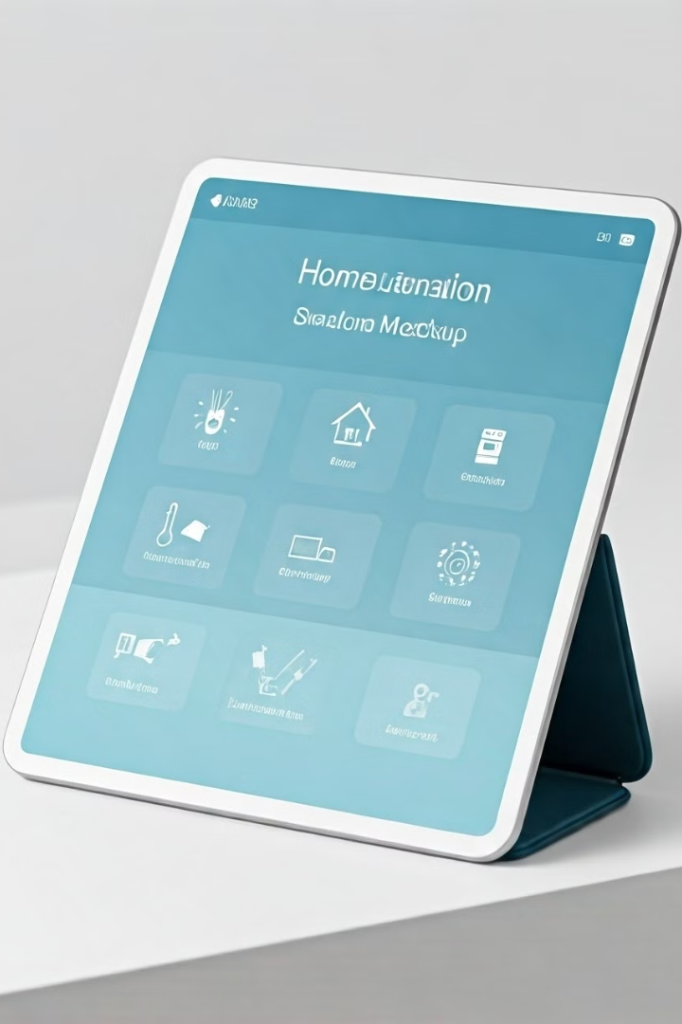
Designing the User Interface with React
1
Component Design
Carefully craft reusable UI components that provide a seamless and responsive user experience.
2
State Management
Implement effective state management strategies to ensure a smooth and efficient interface.
3
Responsive Layout
Develop a responsive layout that adapts to various device sizes and screen resolutions.

Slide 5




Integrating Java for Operational Functionality
Device Integration
Leverage Java's capabilities to seamlessly integrate various smart home devices and sensors.
Automation Algorithms
Develop intelligent algorithms in Java to automate home functions based on user preferences.
Real-time Monitoring
Utilize Java's robust event handling and processing to provide real-time monitoring and control.

Slide 6

Implementing Spring Boot for Backend Solutions
RESTful API
Data Management
Build a secure and scalable RESTful API using the Spring Boot framework.
Integrate the MySQL database with Spring Boot to handle data storage and retrieval.
Microservices
Logging and Monitoring
Adopt a microservices architecture to ensure modularity and maintainability.
Implement robust logging and monitoring mechanisms to ensure system stability and troubleshooting.

Slide 7




Securing the System with JWT and User Authentication
Access Control
Implement JWT-based authentication to secure user access to the home automation system.
Data Encryption
Ensure the confidentiality of user data and system communication through robust encryption.
Biometric Security
Leverage biometric authentication, such as fingerprint or facial recognition, for enhanced security.

Slide 8

Conclusion and Future Enhancements
The comprehensive home automation system showcases the power of integrated technology to transform your living experience. As technology continues to evolve, explore exciting future enhancements to elevate your home's intelligence and convenience.

